Slide 1

BarqiBazar
Presented By
Name
RollNo
M ifraheem
17
Saran Zafar
05
Supervised By: Dr. Khurram Mustafa Abbasi

Slide 2
OVERVIEW
Presentation Outline
  Project Introduction
  Existing Systems vs Our Solution
  Objectives & Core System Functions
  Project Methodology
  System Requirements (Functional & Non-Functional)
  System Design & Architecture
  Implementation, Testing & Deployment
  Real-World Deployment, Results & Future Work
2

Slide 3
Introduction
3

Slide 4
INTRODUCTION
What is BarqiBazar?
  Barqi Bazar is a smart commerce platform connecting stores, customers, franchise admins, and riders.
  It bridges offline retail operations with online ordering and delivery management.
  An offline-capable POS system supports store sales and real-time inventory updates.
  Products are published through a controlled proposal and franchise approval workflow.
  Customer orders follow a structured process including stock validation and routing.
  Delivery is managed using a rider bidding mechanism for efficient assignment.
4

Slide 5
Existing vs Our System
5

Slide 6
EXISTING & OUR SYSTEM
Existing System
Our System
  POS systems work only for in-store sales
  No integration between POS and online platforms
  Uncontrolled product listings reduce quality
  Weak or manual delivery coordination
  No stock validation before online orders
  Lack of multi-city or franchise management
  Disconnected systems cause delays and errors
  Offline-capable POS integrated with online system
  Unified platform for stores, customers, and riders
  Controlled product proposal and approval workflow
  Stock validation and order routing before confirmation
  Rider bidding mechanism for delivery assignment
  Franchise and city-based governance
6

Slide 7
Objectives & Functions
7

Slide 8
BARQIBAZAR
Objectives & Core System Functions
Offline POS Operations
Controlled Product Publishing
Order & Delivery
Rider Bidding
Role based Access Control
Multi city and Franchise based Scalability.
Unified Platform
8

Slide 9
Methodology
9

Slide 10
BARQIBAZAR
Project Methodology
  The project followed the Waterfall Development Model.
  Requirements were gathered and finalized before development.
  System design was completed using UML diagrams.
  Implementation was carried out in well-defined phases.
  Core modules (POS, Portals) were developed first.
  Delivery and rider bidding modules were integrated later.
  Testing and validation were performed after each phase.
10

Slide 11
Requirements
11

Slide 12
REQUIREMENTS
Functional Requirements
Non-Functional Requirements
  Role-based user authentication and login.
  Offline POS support for product management and sales.
  Product proposal submission and approval workflow.
  Customer order placement with stock validation.
  Rider bidding and delivery assignment.
  Secure authentication and authorization mechanisms.
  System scalability for multi-city and franchise operations.
  Reliable data storage and consistency.
  Fast and responsive system performance.
  High availability and system reliability.
12

Slide 13
Architecture & Design
13

Slide 14
BARQIBAZAR
Architecture
Service Oriented
Role base Access
Relational DB
Cloud Deployment
14

Slide 15
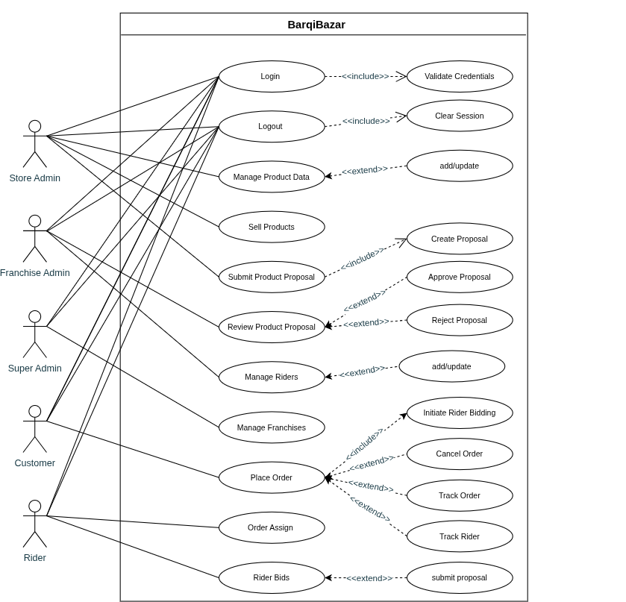
USE CASE DIAGRAM
  Shows actors and roles
  Covers login and product management
  Includes product proposal approval flow
  Shows order placement and tracking
  Represents rider bidding and assignment
15

Slide 16
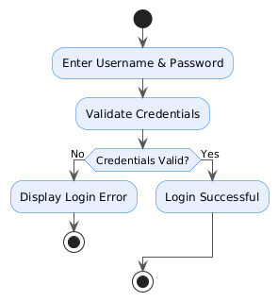
ACTIVITY DIAGRAM
Login
  User enters username and password
  System validates credentials
  If credentials are invalid, an error is shown
  If credentials are valid, login is successful
  Process ends after authentication result
16

Slide 17
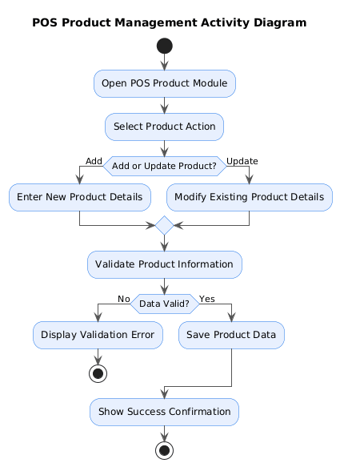
ACTIVITY DIAGRAM
POS Product Management
  Store Admin opens the POS product module
  Chooses to add or update a product
  Enters or modifies product details
  System validates product information
  If data is invalid, an error is shown
  If valid, product data is saved successfully
  System displays a success confirmation
17

Slide 18
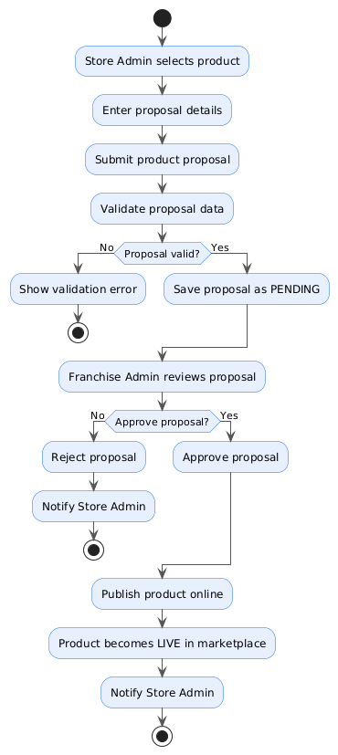
ACTIVITY DIAGRAM
Proposal
  Store Admin selects a product and enters proposal details
  Product proposal is submitted and validated
  If data is invalid, a validation error is shown
  Valid proposals are saved as pending
  Franchise Admin reviews the proposal
  Proposal is approved or rejected
  Approved products are published and go live on the marketplace
18

Slide 19
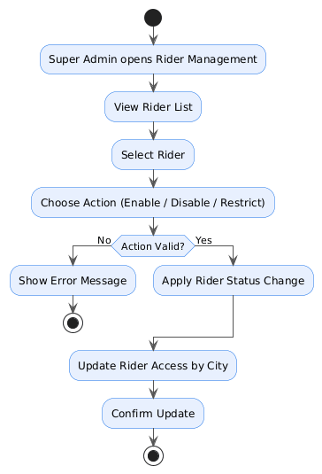
ACTIVITY DIAGRAM
Rider Management
  Super Admin opens Rider Management module
  Views and selects a rider
  Chooses an action (enable, disable, or restrict)
  System validates the action
  If invalid, an error message is shown
  If valid, rider status is updated
  Rider access is updated city-wise and confirmed
19

Slide 20
Implementation,
Testing & Validation
20

Slide 21
BARQIBAZAR
Implementation
  System implemented using a service-oriented architecture
  Core modules: POS, product approval, orders, and delivery
  Role-based dashboards developed for each user type
  Functional testing performed on all major workflows
  Integration testing ensured smooth module interaction
  Validation of login, POS sales, orders, and delivery
21

Slide 22
BARQIBAZAR
Testing & Validation
  Unit Testing – individual modules like login, POS, and order functions
  Integration Testing – interaction between POS, orders, and delivery modules
  Functional Testing – validation of core workflows (login, product, orders)
  System Testing – end-to-end system behavior
  Performance Testing – response time and stability checks
  Security Testing – role-based access and authentication
  User Acceptance Testing (UAT) – real-user validation in deployed environment
22

Slide 23
Real-World Deployment, Results & Future Work
23

Slide 24
BARQIBAZAR
Real-World Deployment & Results
  POS system deployed in a real clinic and operational since last year
  System running on real transactional and inventory data
  Improved sales tracking and operational efficiency
  Validated system stability in real usage
24

Slide 25
BARQIBAZAR
Future Work
  Integration of advanced analytics and reporting for sales and performance insights
  Development of mobile applications for customers and riders
  Improvement of digital payment gateways and wallet enhancements
  Automation of rider assignment and delivery optimization
25

Slide 26
The End
Thank Your for Listening

